Slide 1
Foraging Bees

Slide 2
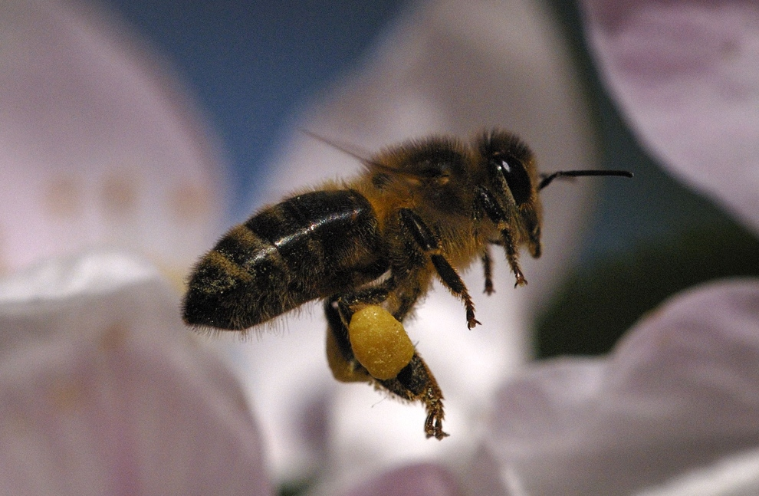
Forage
What do Bees Need?

Slide 3
What do Bees Forage for?
Water
Nectar
Pollen
Propolis

Slide 4
Pollen
Nutrient for bees and larvae
Source of:
Protein
Vitamins
Minerals
Gathered from flowers
Different flowers have different colour pollen
Stored in times of plenty

Slide 5
Nectar
Food for Bees
Gathered from flowers
Contains:
Mostly Water (60-80%)
Sugars (20-40%):
Sucrose
Glucose
Fructose
1-3% Nitrogen compounds, minerals, organic acids, vitamins and aromatic substances

Slide 6
Nectar to Honey
Nectar contains 60-80% water
Honey contains everything that was in the nectar but only 17% -20% water
Why?
Honey is the bees winter food supply
The low water content prevents fermentation

Slide 7
Water
Brought in to dilute honey so bees can digest it
Removed by fanning when nectar is turned into honey
This also cools the hive

Slide 8
Water Balance
Stored honey
20% water
Worker’s honey stomachs 50% water
Water used in daily metabolism
Water carriers bring 100% water
Nectar averaging
60-80% water

Slide 9
Propolis
Bee glue
From Latin meaning ‘before the city’ – sometimes used to narrow entrance
Generally 55% resins & balsams, 10% aromatic oils
Antibiotic and antifungal properties
Gathered from tree buds and resins
Anything sticky will do:
Wet paint
Varnish
Tar
Uses:
Narrowing entrances & plugging holes
Waterproofing/draught-proofing hive
Sticking everything down

Slide 10
Can We Use Propolis?
Because of it’s Antibacterial property Propolis is used in:
Lipbalm
Throat Spray
Toothpaste
Mouthwash
Anaesthetic effect on gums when chewed
Propolis can contain Frankincense and Myrrh, plant resins that have been traded for centuries.

Slide 11
Pollen Basket or Corbicula
Two baskets per bee on hind pair of legs
Made of stiff bristles
Used to carry Pollen or Propolis
Pollen gatherers unload themselves into cells
Propolis gatherers are specialists

Slide 12
What is Honey?
Over 180 substances identified in Honey
Fructose (about 38%)
Glucose (about 31%)
Water (about 18%)
Other ingredients include:
Maltose; sucrose; vitamins; minerals
Honey is an acid, with a pH range from 3.4 to 6

Slide 13
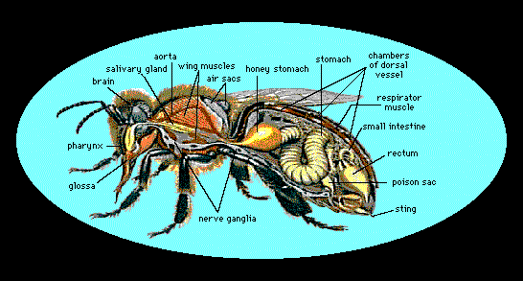
Honey Stomach
Nectar & water
Foragers are unloaded by house bees

Slide 14
Honey’s Healing Properties
Honey is Hygroscopic (absorbs water)
Beneficial applied to wounds
Used by soldiers for centuries
Re-emerged as treatment for burns
Effective against MRSA
Local Honey for Allergies ? ?

Slide 15
Interesting (Useless) Fact:
Alexander the Great, who conquered the known World and died thousands of miles from home, was preserved in a golden coffin filled with Honey for the journey home…

Slide 16
Honey’s ‘Best Before’ Date
Best Before it Leaves the Hive!
Designed by Nature to be Stored
Acid – Inhibits bacteria & Prevents Spoiling
BB >10yrs – Australia does not have BB for Honey
Fructose degrades slowly to hydroxymethyfurfuraldehyde (HMF)
Overheating increases HMF quickly
HMF spoils quality of honey

Slide 17
Sources of Propolis

Slide 18
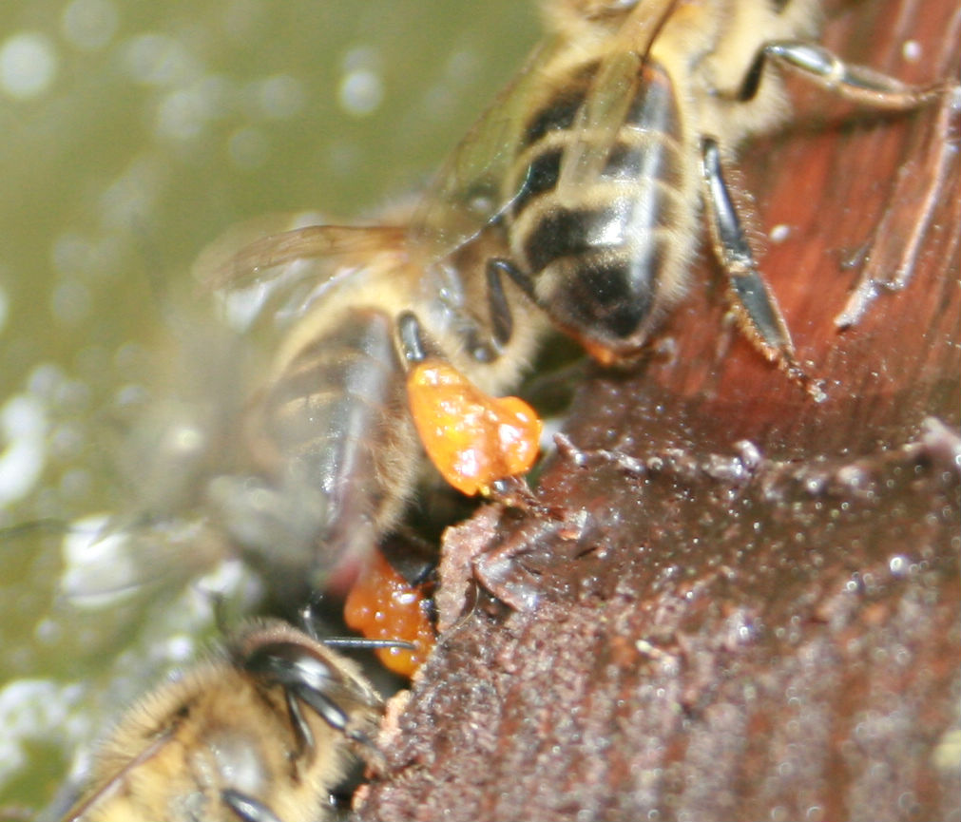
Bees gathering propolis

Slide 19
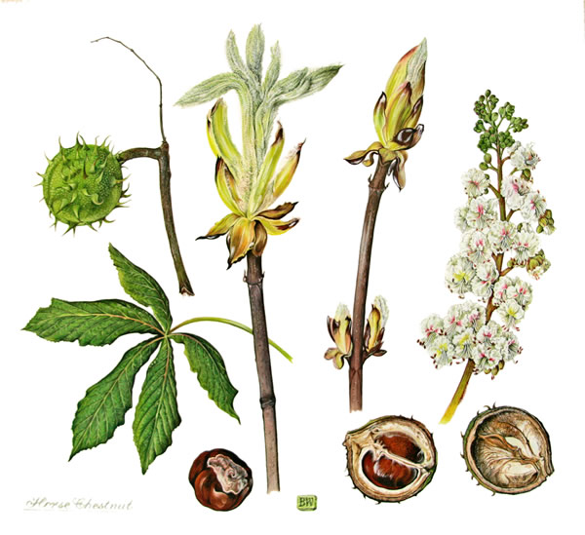
Sticky buds

Slide 20
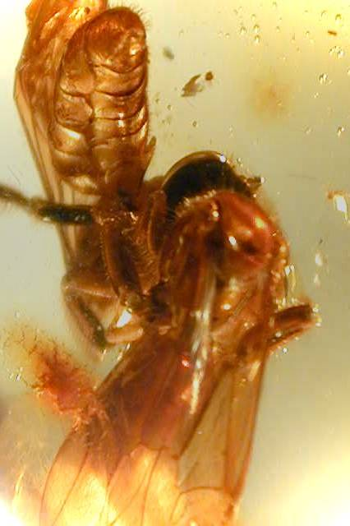
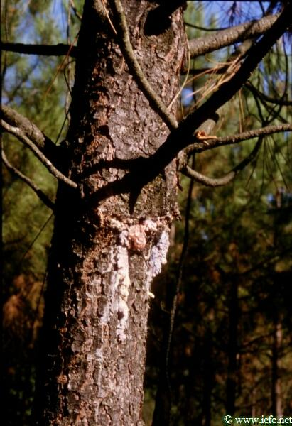
Tree resins
Bee in amber caught in resin millions of years ago and fossilized

Slide 21
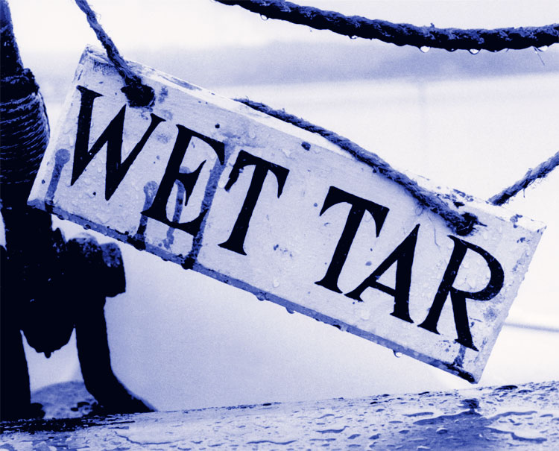
Sources of Propolis

Slide 22
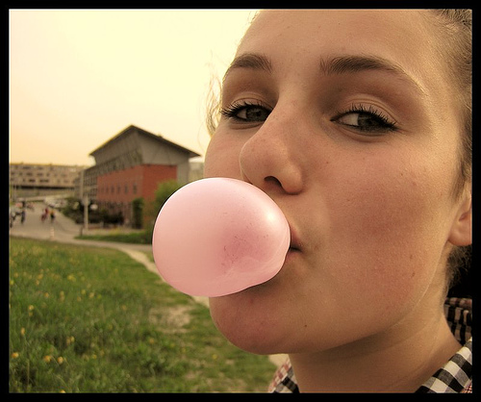

Slide 23
The Floral Year

Slide 24
Interesting Forage Facts
Bees will visit about 2,000 flowers during a day’s forage.
On each forage flight, a bee will only visit flowers of the same species
In it’s lifetime, an individual honeybee will make about one twelfth of a teaspoon of honey.
Honey bees are the only insect that produce food eaten by humans

Slide 25
Bee Plants: Jan - Feb - Mar
Crocus
Snowdrop – Galanthus***
Mahonia (Dec – May)
Grape Hyacinth – Muscari
Willow – Salix***
Goat Willow (Pussy Willow) – S. caprea
Gorse
Hazel

Slide 26
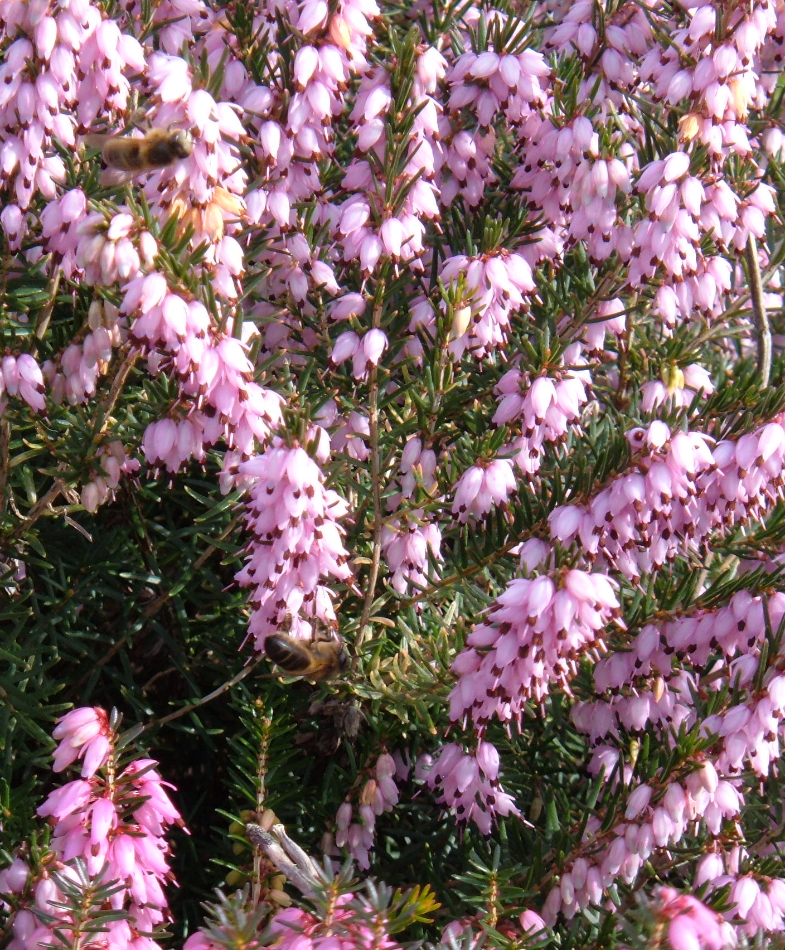
Garden Heathers (Erica spp)
December - April
Nectar and Pollen
Pollen loads White

Slide 27
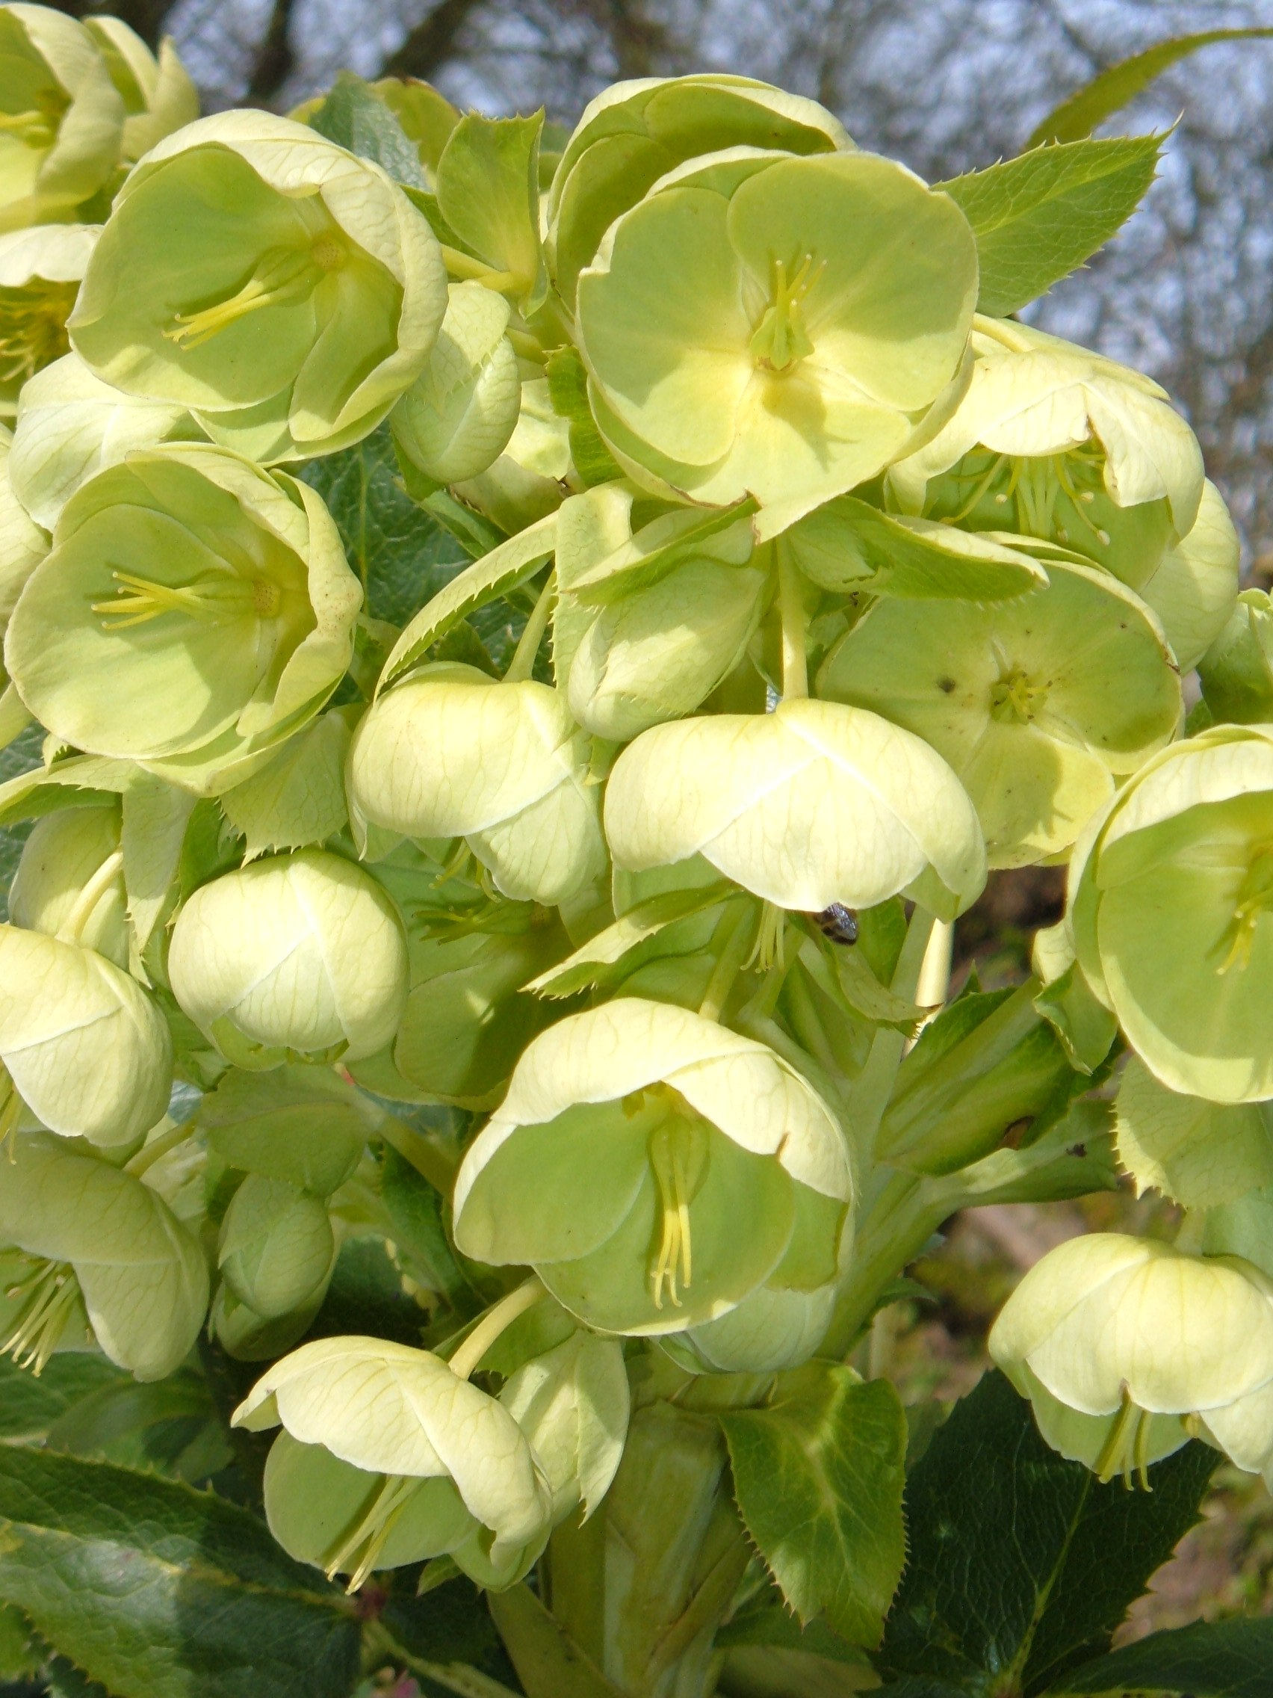
Hellebore
January to April
Pollen & Nectar

Slide 28
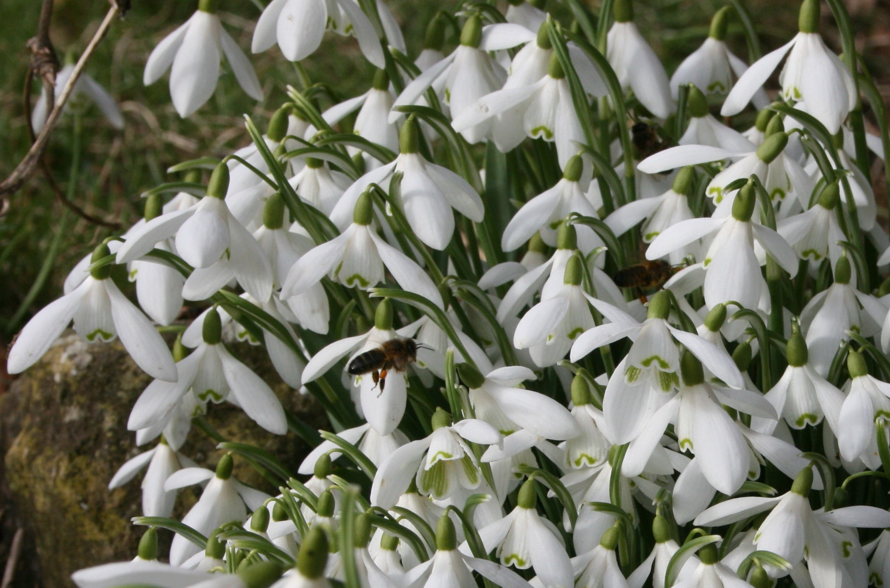
Snowdrops
December – February
Pollen (orange) and Nectar

Slide 29
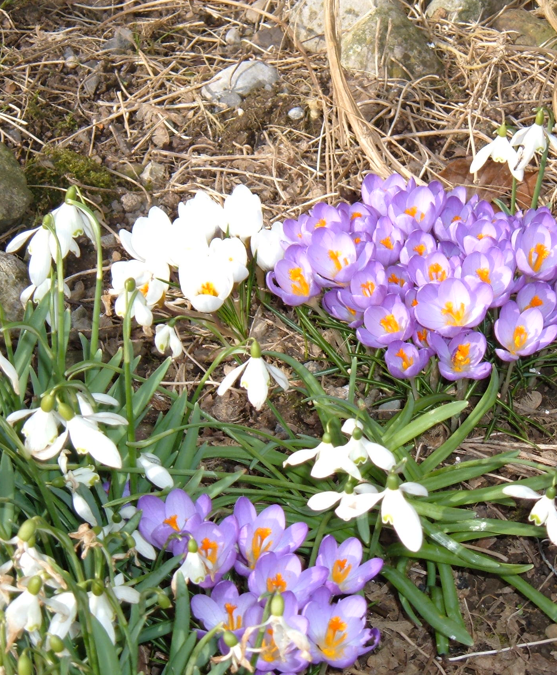
Crocus
Feb to March
Pollen (orange) & Nectar

Slide 30
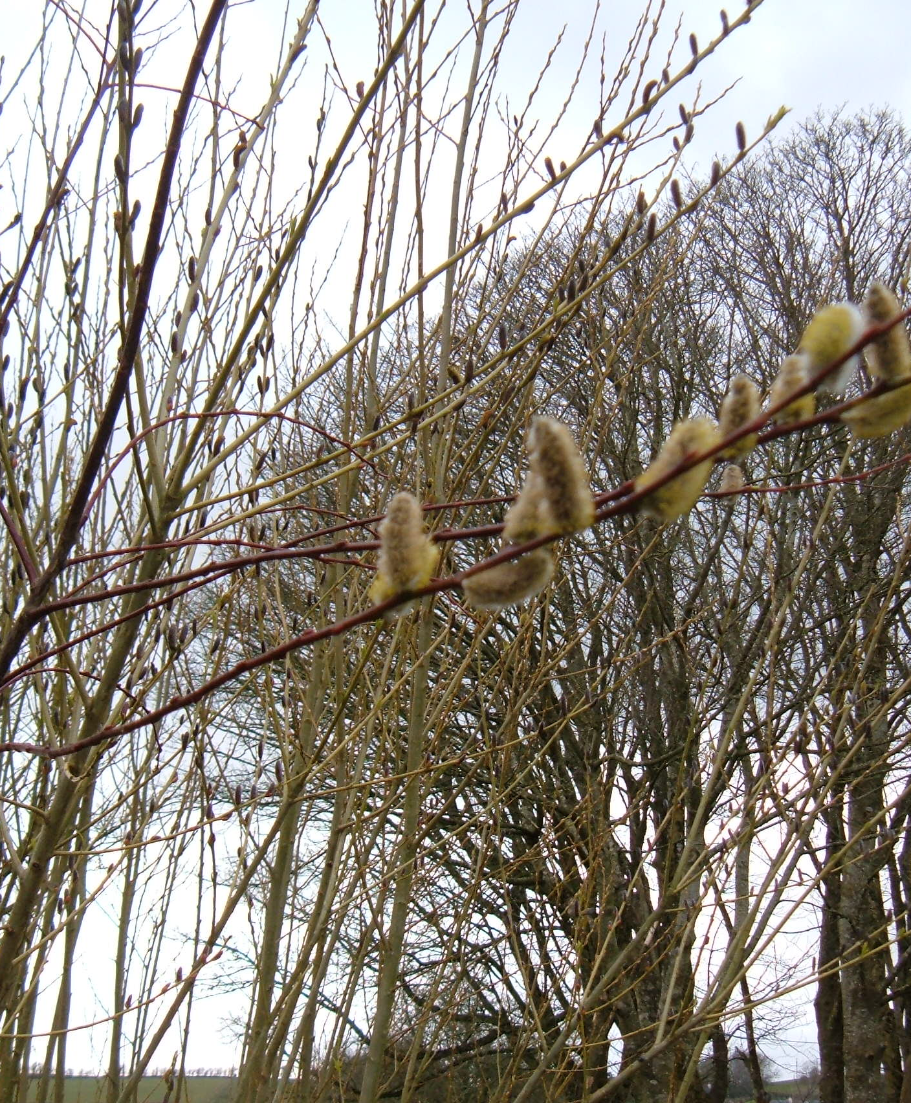
Willow
Feb to March
Pollen Yellow
Nectar
Important Early Spring Source

Slide 31
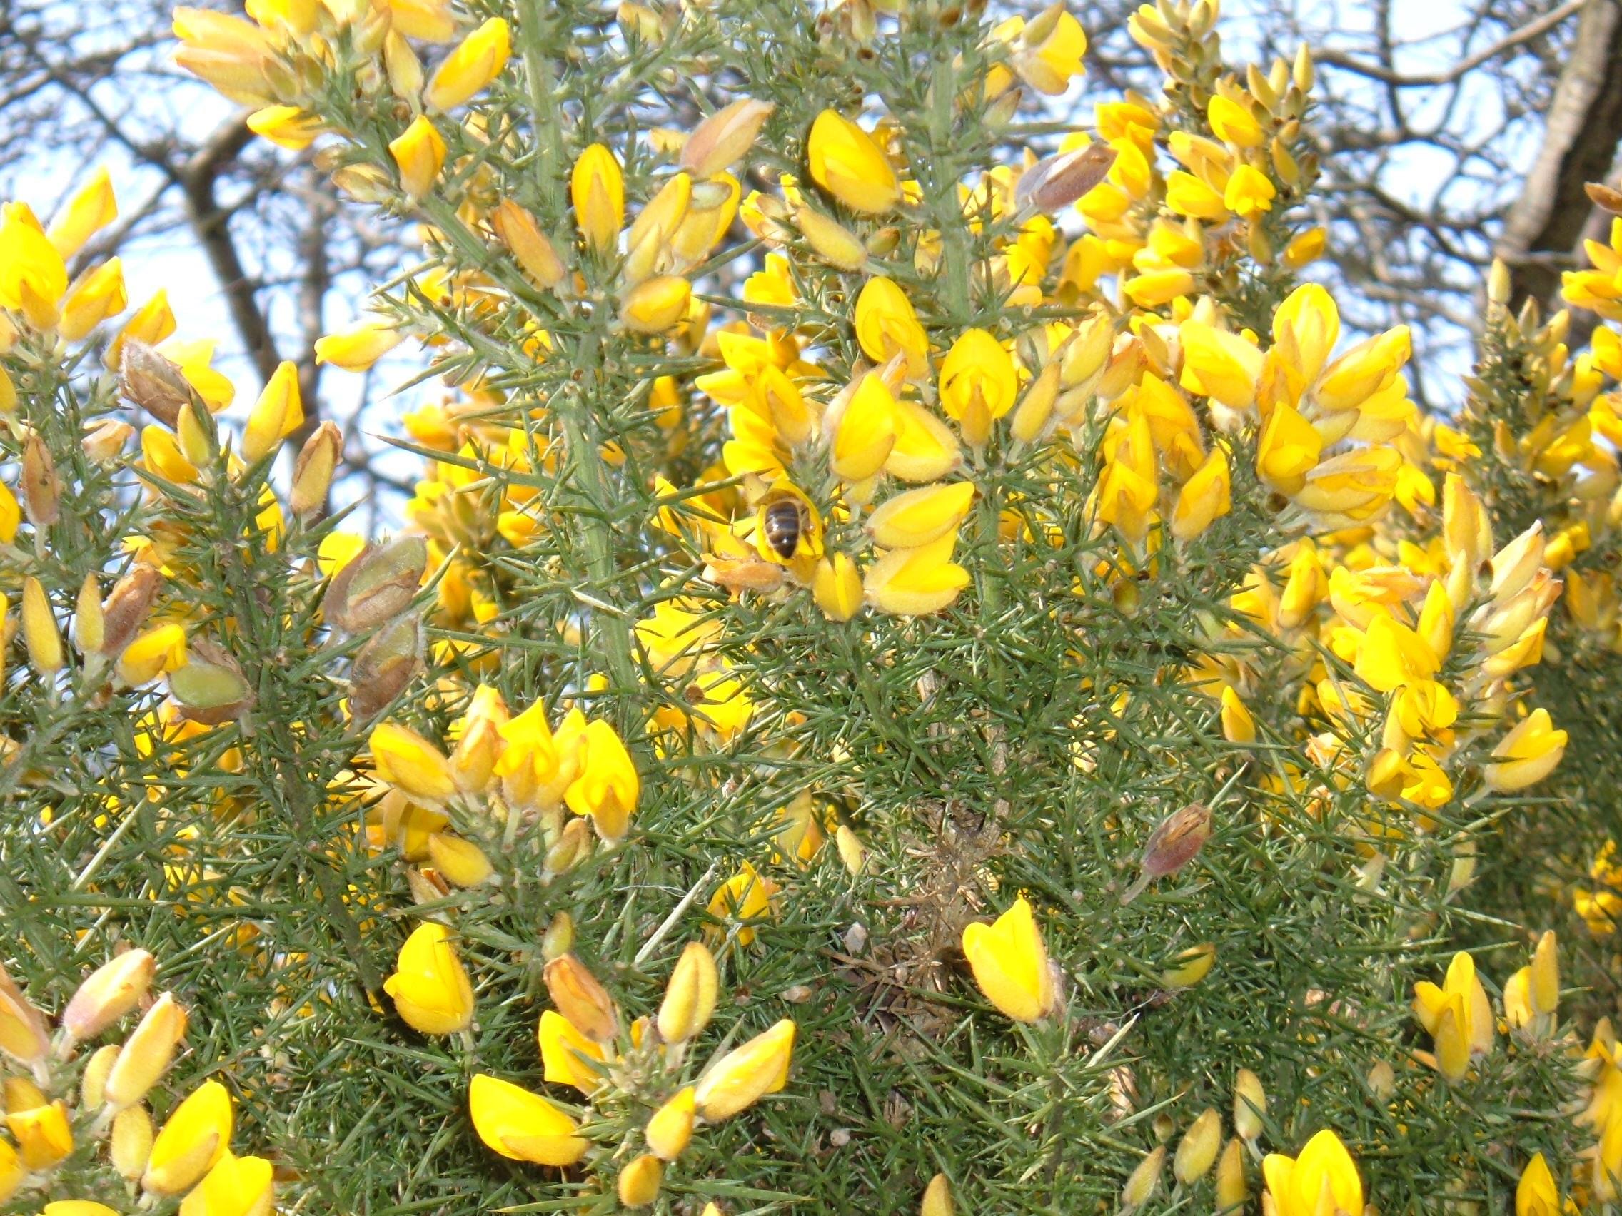
Gorse
Feb – May
Pollen
(Orange/Brown)
No Nectar
Early Pollen Source

Slide 32
Bee Plants – Apr May
Forget-me-nots
Cotoneaster
Poached Egg Plant
Blackthorn, Hawthorn
Dandelion
Gooseberry, Currant
Rape
Sycamore, Horse Chestnut
Laurel, Holly

Slide 33
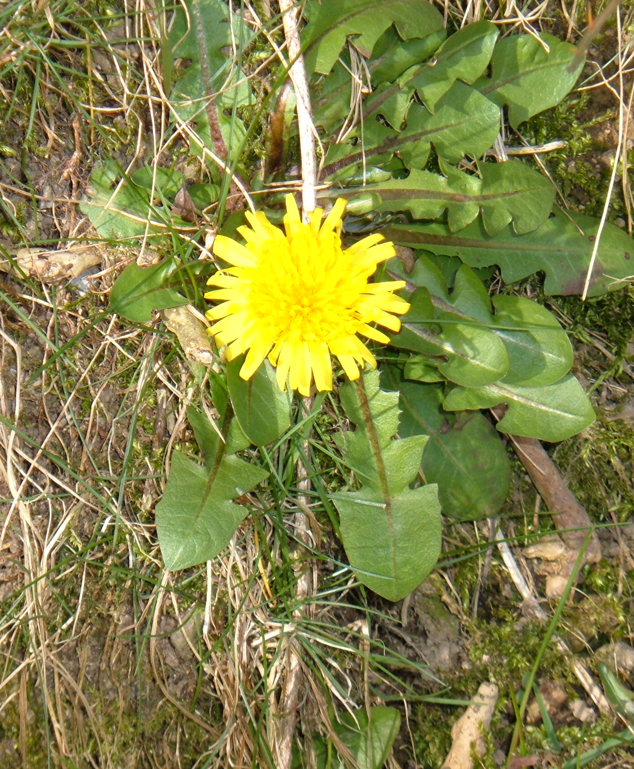
Dandelion
April - June
Nectar
Pollen (deep yellow)
Possible honey crop

Slide 34
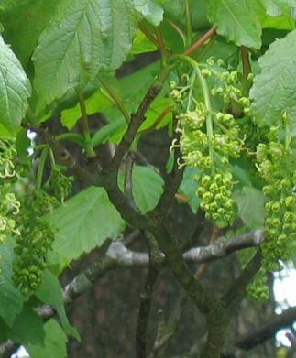
Sycamore
May
Nectar
Pollen (grey/green)
Probable honey crop

Slide 35
Bee Plants – Jun Jul Aug
White Clover
Blackberry
Field Beans
Raspberry
Lime
Willow Herb
Lavender
Sage, Thyme, Oregano
Geranium

Slide 36
Hawthorn
May – June
Pollen (cream)
Nectar
Unreliable
1/7 year
Wonderful honey

Slide 37
White Clover
June – September
Nectar (>20 deg C)
Pollen (brown)
Main crop

Slide 38
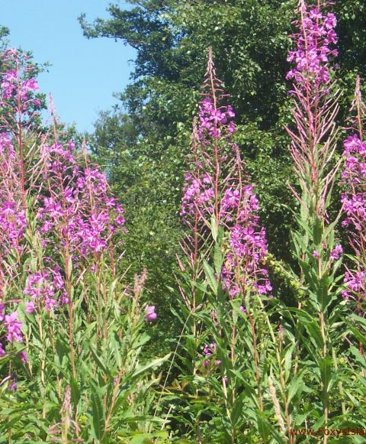
Rosebay Willow Herb or Fireweed
July- August
Blue pollen
Good crop
Pale honey

Slide 39
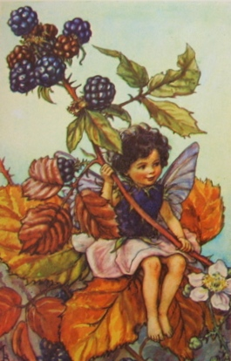
Blackberry
Nectar and Pollen (pale grey)
July – September
Main crop

Slide 40
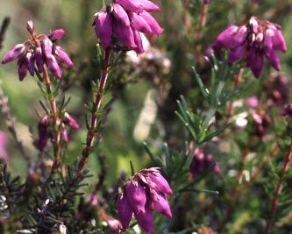
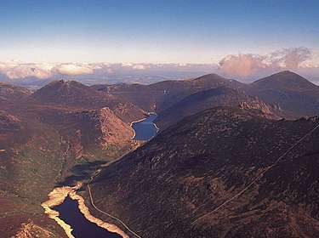
Erica tetralix or Cross-leaved heath
July – August
V. dark honey
Will extract

Slide 41
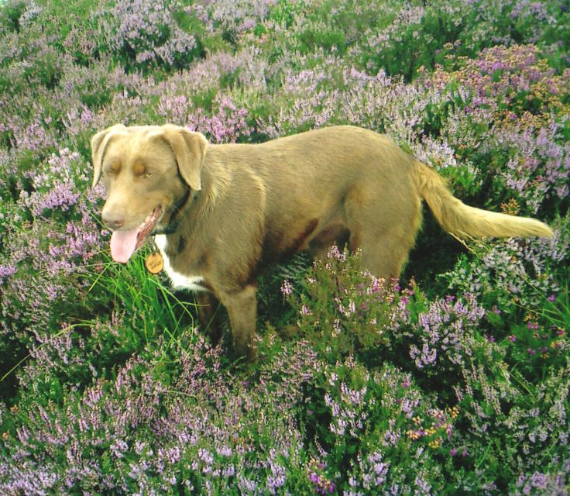
Ling heather (Calluna vulgaris)
August – Sept
Nectar & Pollen (white)
Excellent honey
Unreliable
‘Thixotrophic’
– won’t extract
Often sold in comb

Slide 42
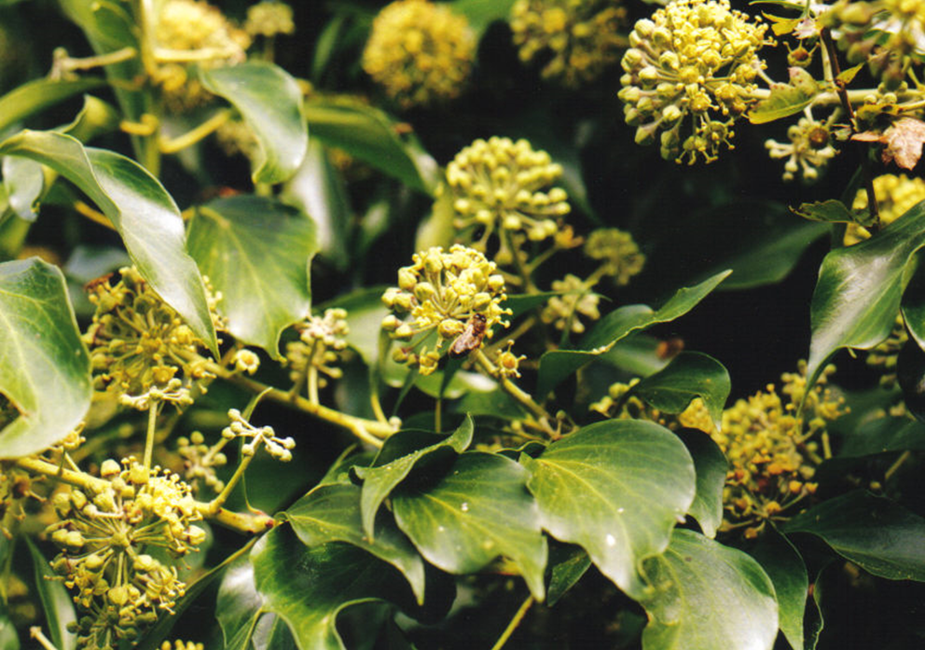
Ivy
Nectar and Pollen (yellow)
Sept – Nov
Horrible honey
Important winter stores

Slide 43
Bee Plants – Sep Oct Nov
Evening Primrose
Ivy (Hedera Helix) – Oct to Dec
Deadnettles – Lamium – (Feb to Nov!!)
Best for Bumblebees

Slide 44
Pollination
Pollen is gathered from anthers (male)
Delivered to stigma (female)
Fertilises flower
Important yield-increasing service farmers will pay for in other countries

Slide 45
Basic Botany

Slide 46
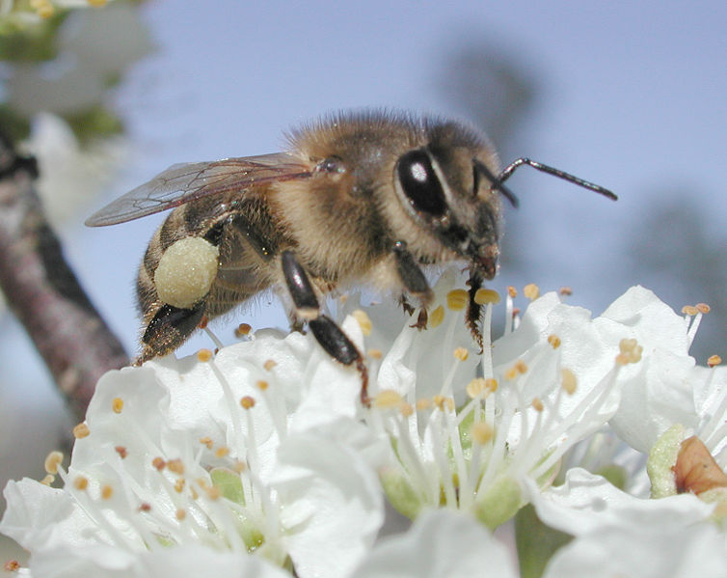

Slide 47
Some Crops Pollinated by Bees

Slide 48
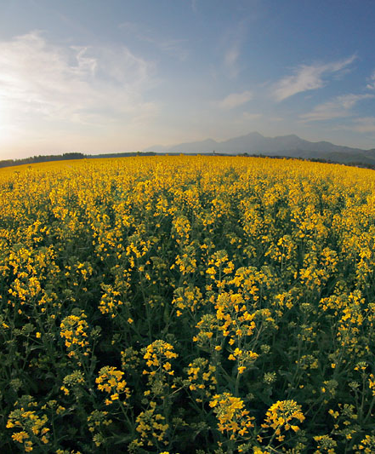
Oilseed Rape
Bio-Fuel Crop
April – May
Pollen (Yellow)
Nectar
High Yield
Extensive use of chemicals

Slide 49
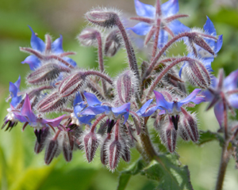
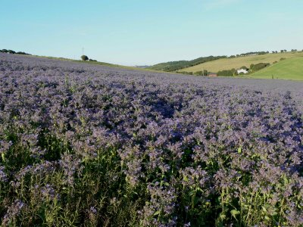
Borage or ‘Starflower’
June-August
Pollen (Bluish Grey)
Nectar
Heavy honey crops
Pale green Honey

Slide 50
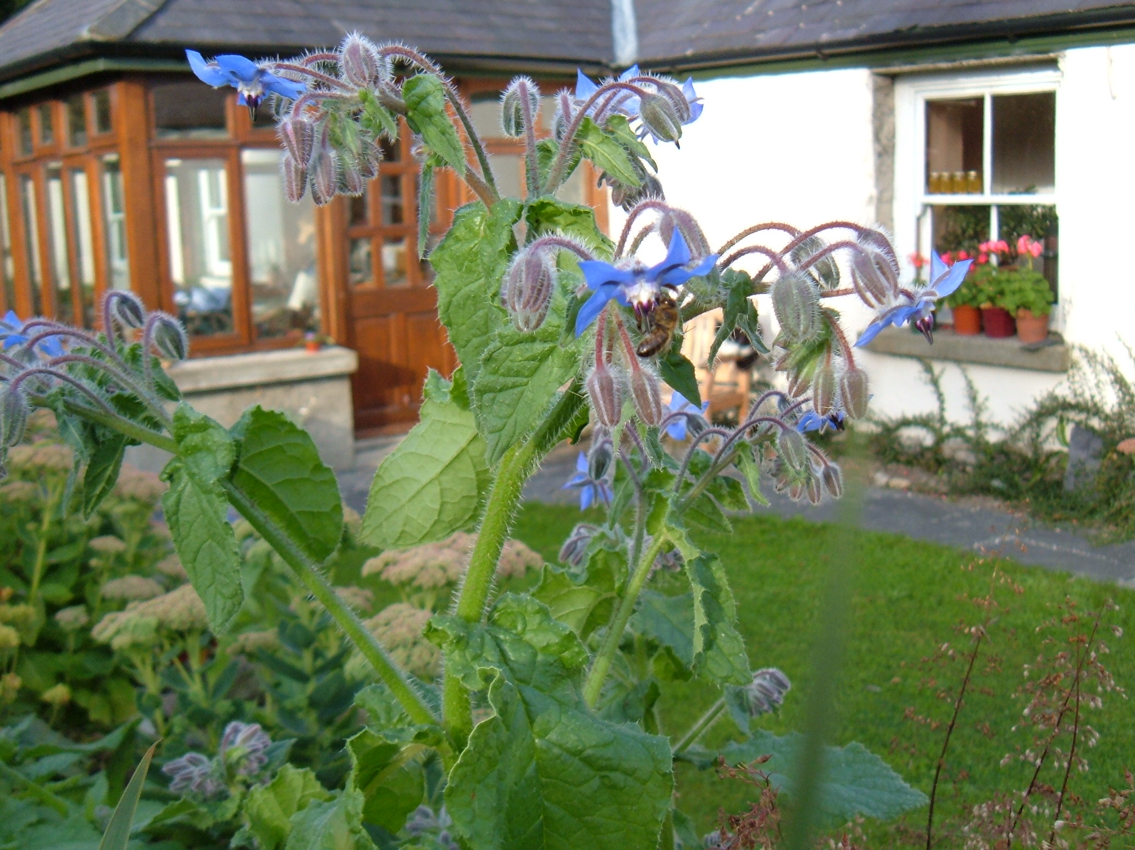
Borage as a garden flower

Slide 51
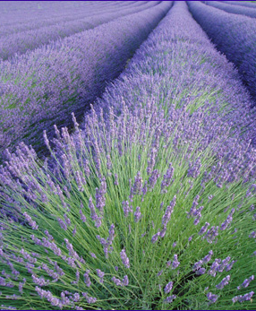
Lavender
Perfumed oil and flower-heads
Provence, Oregon & Kilmacanogue
Very good honey

Slide 52
Migratory Beekeepers U.S.
Apples
Apricots
Almonds
Plums
Cranberries
Pears
Melons
Cherries
Sunflower
Lemons
Cucumbers
Oranges
Cotton
Sweet Clover
Mesquite
Catclaw
Tamarix
Safflower
Lima Beans
Starthistle
Limes
Sage
Lavender
Grapefruits
Fireweed
Oilseed Rape
Alfalfa
Blueberries
Buckwheat
Ladino clover
Onions!

Slide 53
Foragers for the Flow
Max egg laying
End May
Max Foraging Bees
Early to mid July

Slide 54
Questions?

